Slide 1
Weight Change Prediction Model
Using dietary habits, physical activity levels, and lifestyle factors to predict weight change over time
Rafi Qamar
13 November 2024

Slide 2
Project Overview
Objective: Predict weight change based on features like caloric intake, activity level, sleep quality, and stress.
Key Goal: Identify influential factors to provide actionable key insights & advice for weight management strategy.

Slide 3
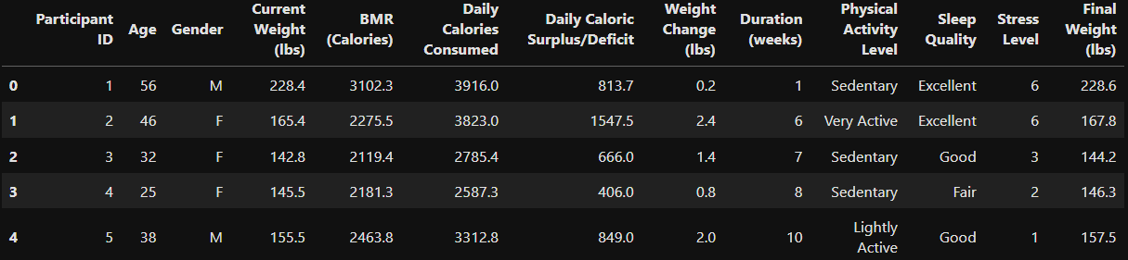
Data Overview
Dataset Source: Kaggle Link
Features Included: Age, Gender, Current Weight, BMR, Daily Calories, Physical Activity Level, Sleep Quality, Stress Level, and more.
Sample Rows:

Slide 4
Exploratory Data Analysis (EDA)
Data Summary:
100 entries with 13 columns.
We have zero missing values and all data types are already correct.
Key Findings:
Correlation analysis suggests weak relationships between individual features (e.g., Daily Caloric Surplus/Deficit and Weight Change).
Relationships may be interactive rather than linear.

Slide 5
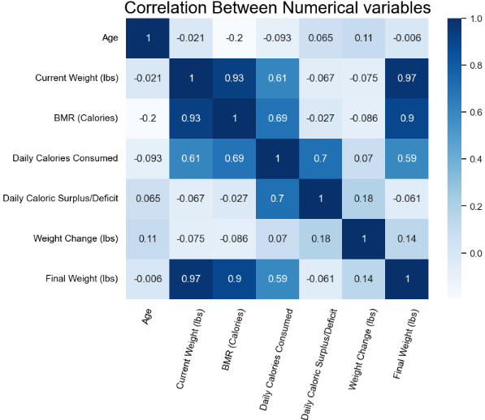
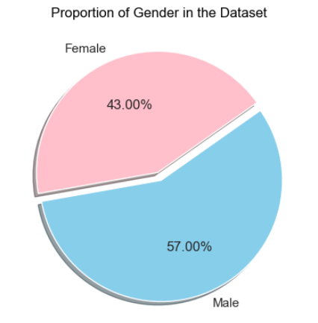

Slide 6
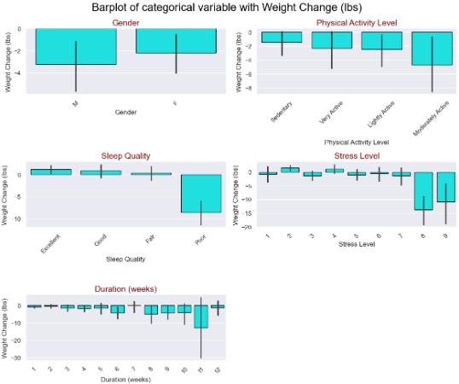

Slide 7
Feature Engineering and Preprocessing
Outliers: Yeo-Johnson transformation applied to Weight Change to reduce outlier effects.
New Features:
Caloric Intake Per Weight
Physical Activity MET Value
Activity Weighted Calories
Dropped Columns:
Final Weight (to avoid target leakage)
Redundant features (Caloric Intake Per Weight, Physical Activity Level, BMR)

Slide 8
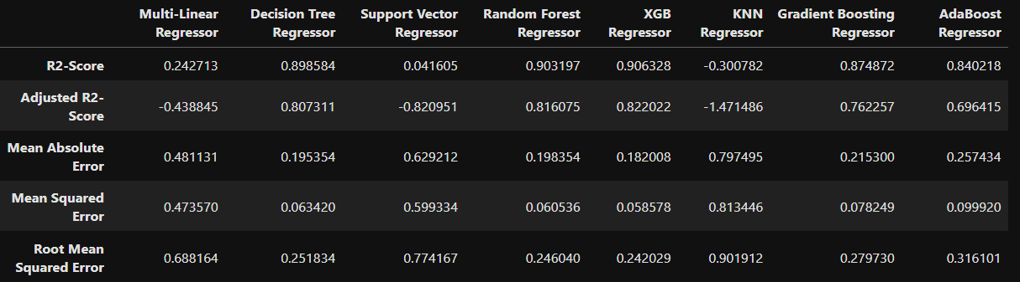
Modeling Process
Models Tested:
List models like Multi-Linear Regressor, Decision Tree, Random Forest, XGB, etc.
Evaluation Metrics: R², Adjusted R², Mean Absolute Error (MAE), Mean Squared Error (MSE), Root Mean Squared Error (RMSE)
Best Model Pre-Optimization:
XGB Regressor: Highest R² of 0.906, indicating strong predictive performance.

Slide 9
Hyperparameter Tuning
Optimization Approach:
Fine-tuned parameters using grid search (e.g., learning rate, max depth, subsample).
4860 fits performed for optimal settings.
Best Parameters:
'learning_rate': 0.2,
'max_depth': 4,’
min_samples_leaf': 1,
'min_samples_split': 2,
'n_estimators': 100,
'subsample': 0.9

Slide 10
Model Performance After Optimization
Training Results:
R2 score: 0.998
Adjusted R2 score: 0.998
MSE: 0.029, MAE: 0.002, RMSE: 0.044
Testing Results:
R2 score: 0.944
Adjusted R2 score: 0.911
Significant reduction in MAE, MSE, and RMSE, showing improved accuracy and robustness.

Slide 11
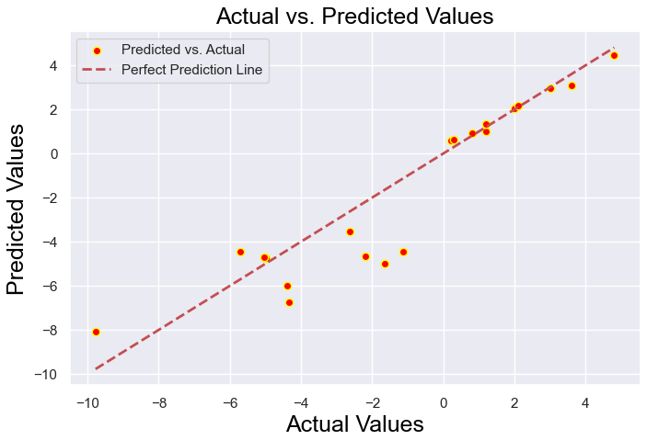

Slide 12
Feature Importance
Most Important Features:
Sleep Quality (75.2%)
Stress Level (14.8%)
Duration (4.3%)
Daily Caloric Surplus/Deficit (3.9%)
Insights:
Sleep Quality and Stress Level are major predictors.
Caloric Surplus/Deficit and Duration have moderate influence.
Age, Gender, Current Weight have minimal predictive value.

Slide 13
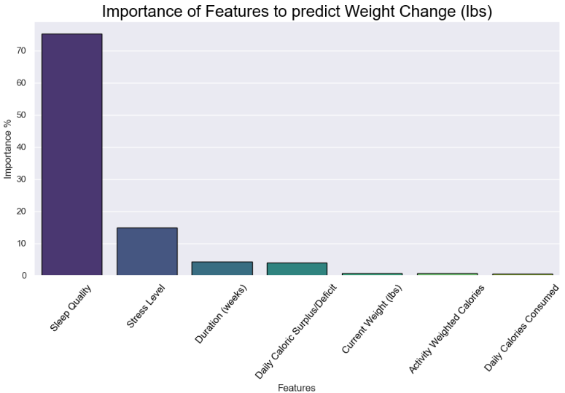

Slide 14
Recommendations
Improving Weight Management:
Prioritize sleep quality improvement and stress management.
Regular physical activity and balanced caloric intake are essential.
Monitor progress regularly to make necessary adjustments.

Slide 15
Conclusion and Future Work
Conclusion:
Model predicts weight change effectively, with key factors identified.
Provides relevant advice based on user inputs and predicted weight change.
Hyperparameter tuning significantly improved model accuracy.
Future Work:
Test model on a larger dataset for generalizability.
Explore additional features such as diet quality or genetic factors.

